Slide 1

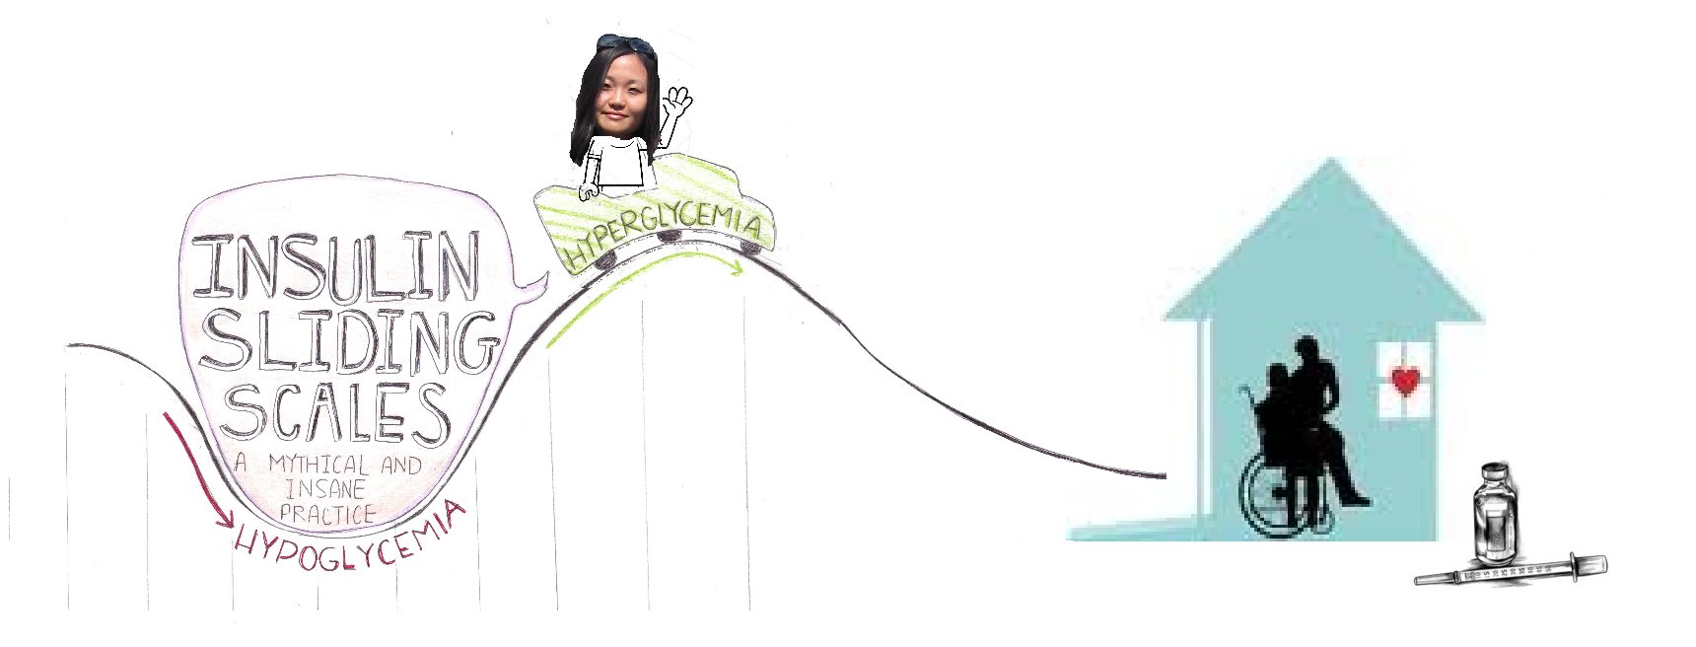
Insulin sliding scales:
A mythical and INSANE PRACTICE
Presenter: Michelle Fong, BScPhm Candidate 2013

Slide 2
Learning Objectives
Identify pitfalls of using a insulin sliding scale (ISS)
Recognize the problem associated with using ISS in LTC
Identify the barriers to change
Role of the pharmacist in overcoming the barriers
Notes:
Has anyone here seen sliding scales prescribed in practice. If you have can you tell me where you were practicing?

Slide 3

What are Insulin Sliding Scales (ISS)?
Chart, not a physical scale
Form of insulin therapy regimen
Commonly seen in hospital and long-term care settings
Practice with >70 year history
Jain VV, Taksande B. Sliding scale insulin therapy-evidence based rebuke.J MGIMS 2008.13(2) 29-31
Image from:http://www.philgalfond.com/wp-content/uploads/ethics-scale.jpg
Notes:
-Insulin therapy: therapy used by type 1 and type 2 diabetics because they do not naturally produce them on their own or are resistant to them. Insulin is an important peptide hormone required by the body in order to take up glucose from the blood into surrounding tissue, which is necessary for cells to properly function
-Not some physical scale, but a chart that tells you how much insulin you need to give yourself at meals based on blood glucose levels
-Used as early as in the 1930s

Slide 4
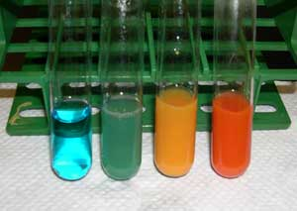
Origin of ISS: “Rainbow Coverage”
Urine glucose monitoring
Boil urine sample with solution containing copper sulfate
Color changed based on amount of glucose in urine
Fehling Solution Test
1934 Sliding Scale by Elliot Joslin
Urine Color | Amount of Regular Insulin to administer
Blue | 0 units
Green | 5 units
Yellow | 10 units
Orange | 15 units
Umpierrez GE, Palacio A, Smiley D. Sliding scale insulin use: myth or insanity? Am J Med 2007; 120: 563– 567
Image from:http://edusanjalbiochemist.blogspot.ca/2013/01/urinalysis-chemical-examination.html
Notes:
-inconvenient
-Regular insulin was administered based on a retrospective amount of glycosuria
-only regular insulin was available at the time

Slide 5
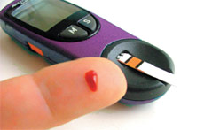
Today’s Insulin Sliding Scale
Example of an Insulin Scale
Blood glucose monitoring
Use of glucometer
Usually regimens for rapid-acting or short-acting insulin
Schedule:TID-QID
Blood glucose (mmol/L) | Amount of NOVORAPID Penfill to Administer
<=10 | 0 units
10.1-12.0 | 2 units
12.1-14.0 | 3 units
14.1-16.0 | 4 units
16.1-18 | 6 unit
18.1-20 | 8 units
>20 | 10 units then recheck BS after 15 min
REACTIVE APPROACH
Jain VV, Taksande B. Sliding scale insulin therapy-evidence based rebuke.J MGIMS 2008.13(2) 29-31
Image from: http://www.myhealthguardian.com/health-monitor/glued-to-gadgets
Notes:
-sliding scale modified to use blood glucose instead of urine glucose
-Based on single, blood glucose reading from a glucometer
-Retrospective: Treating Hyperglycemia once it has already occurred and nothing can change that. It is like closing the barn door AFTER the animals ran away. In other words TOO LATE

Slide 6
Advantages & Disadvantages of ISS
Advantages
Can initiate right away
Simple
Disadvantages
Not individualized
“Reactive Approach”
Convenient
Not evidence based practice
Creates a “roller coaster” effect
Umpierrez GE, Palacio A, Smiley D. Sliding scale insulin use: myth or insanity? Am J Med 2007; 120: 563– 567
Notes:
Advantages
-Conveneint for the physicians: they do not need to called in unless blood glucose is really high or really low
-Simple and easy for nurses to follow
-Can initiate right away without doing any sort of calculations bc most physicians do not actually tailor the sliding scale to the patient standing infront of them-they have a generic sliding scale that they are comfortable with and will use on all patients. Therefore, ISS are more often than not, not individualized
-Assumes all patients have similar insulin sensitivities or no change in insulin sensitivities during an acute illness
Disadvantages
-Not evidence-based “nightmare for pharmacist”
-In the last 50 years, not a single publication has shown ISS to be beneficial in improving blood glucose control or clinical outcomes
-Probably due to the fact that it is a reactive approach to diabetic care

Slide 7
Studies on Insulin Sliding Scales
Poorly studied
Medline search 1966-2003 on “sliding scale insulin”
52 publications
None described benefits
All concluded that ISS are inappropriate
Limitations to the studies include (general)
  Open label
  Inpatient only
  No double blinded study
  Most evidence for Type 2 Diabetes
Browning LA, Dumo P. Sliding-scale inulin: An antiquated approach to glycemic control in hospitalized patients. Am J Health-Syst Pharm. 2004; 61:1611-4.
Notes:
Lack of good quality evidence

Slide 8
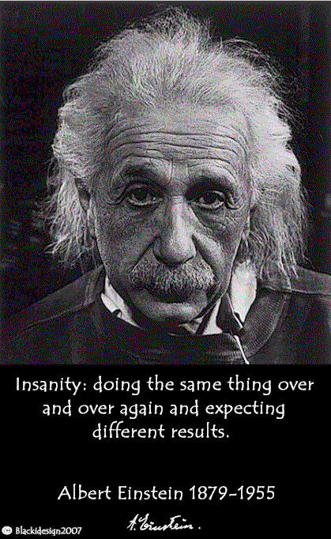
How Literature Describes ISS
“paralysis of thought”
“actions without benefits”
“relic of the past”
“recipe for diabetic instability”
“mindless medicine”
“nonsense”
“Death to sliding scale”
“Myth or insanity”
Umpierrez GE, Palacio A, Smiley D. Sliding scale insulin use: myth or insanity? Am J Med 2007; 120: 563– 567
İmage from:http://www.diabetes-warrior.net/2010/04/28/insanity-is/
Notes:
-Strong messages against insulin sliding scales
-Einstein defined insanity as doing comething over and over agains and expectin different result. Is that not what we have been doing? Using form of practice that has not been shown to be beneficial for the last 50+ years? Sounds pretty insane to me!

Slide 9
Advantages & Disadvantages of ISS
Advantages
Can initiate right away
Simple
Disadvantages
Not individualized
“Reactive Approach”
Convenient
Not evidence based practice
Creates a “roller coaster” effect
Umpierrez GE, Palacio A, Smiley D. Sliding scale insulin use: myth or insanity? Am J Med 2007; 120: 563– 567
Notes:
Advantages
-Conveneint for the physicians: they do not need to called in unless blood glucose is really high or really low
-Simple and easy for nurses to follow
-Can initiate right away without doing any sort of calculations bc most physicians do not actually tailor the sliding scale to the patient standing infront of them-they have a generic sliding scale that they are comfortable with and will use on all patients. Therefore, ISS are more often than not, not individualized
-Assumes all patients have similar insulin sensitivities or no change in insulin sensitivities during an acute illness
Disadvantages
-Not evidence-based “nightmare for pharmacist”
-In the last 50 years, not a single publication has shown ISS to be beneficial in improving blood glucose control or clinical outcomes
-Probably due to the fact that it is a reactive approach to diabetic care

Slide 10
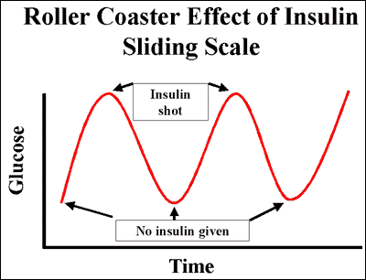
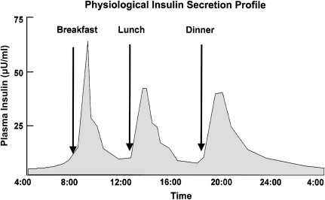
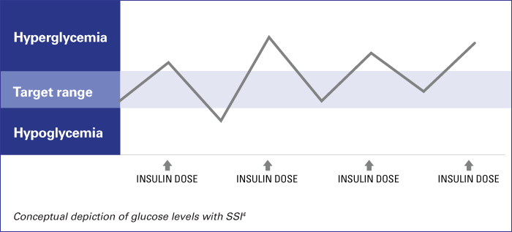
Fluctuating glucose levels may be a predictor of diabetic complications, independent of HbA1C levels
Nalysnyk L, Hernandez-Medina M, Krishnarajah G. Glycaemic variability and complications in patients with diabetes mellitus: evidence from a systematic review of the literature. Diabetes Obes Metab. 2010;12(4):288-298
Russel D.Insulin Pump Therapy (Continuous Subcutaneous Insulin Infusion)Primary Care: Clinics in Office Practice 2007;34(4):845-871
Image from:. http://www.endotext.org/diabetes/diabetes19/diabetesframe19.htm
Notes:
-if rapid-acting is given with previous meals, its effects last only 3-4 hours, then the patient may experience high blood glucose level for several hours prior to the next dose of insulin given
-Another problem is that patient does not receive insulin when blood glucose levels are normal. But in few hours (postmeal) BG will rise leaving the patient with long periods of high blood glucose levels
-There are evidence suggesting the effects the fluctuating glycose levels could be a predictor of diabetic complications independent of HbA1C-Verona diabetes study

Slide 11

“Proactive” Approach to Care
Anticipate major change in blood glucose levels and prevent them from occurring
  Insulin therapies that mimic physiological release of insulin
  The 3 “rights”
Individualized basal-bolus insulin therapies (BBI)
  Evidence-based
Umpierrez GE, Smiley D, Zisman A. et al. Randomized study of basal-bolus insulin therapy in the inpatient management of patients with type 2 diabetes (RABBIT 2 trial). Diabetes Care 2007;30: 2181– 2186
Notes:
Right type of insulin,In the right amount,Right time ,To meet the insulin needs of the patient

Slide 12
Definitions
Basal Insulin:
  Prevents between meal and overnight hyperglycemia
Bolus insulin:
  Limits hyperglycemia after meals
Kitibachi AE, Nwenye E. Sliding-scale insulin: more evidence needed before final exit? Diabetes Care 2007;30:2409-2410
Image from:. http://www.endotext.org/diabetes/diabetes19/diabetesframe19.htm
Notes:
-basal insulin (intermediate-acting or longer-acting insulin)-peakless, long-lasting
-bolus insulin (short acting or rapid acting insulin)
-correction scale: used correction factor therefore tailored to patient’s insulin sensitivity
Use on top of standing order
-In long-term care facilities, food and activity are predictable and the residents are usually more stable, except during times of illness. There should be minimal need for insulin correction doses
-Correction factor
 number of mmol/L of blood glucose that will drop with 1 unit
of rapid acting insulin
= 100/TDD (TDD = Total Daily Dose of insulin)

Slide 13
Definitions cont.…
Traditional Insulin Sliding Scales:
  No basal insulin
Supplemental Scale or Correction Scale:
  ISS + (basal insulin +/- bolus insulin)
  Primarily used
    As dose-finding strategy (bolus insulin dosage)
    As a supplement when rapid changes in insulin requirements (i.e. stress or illness)
Notes:
-rapid changes in insulin requirements leading to hyperglycemia-stress or illness
-In long-term care facilities, food and activity are predictable and the residents are usually more stable, except during times of illness. There should be minimal need for insulin correction doses

Slide 14
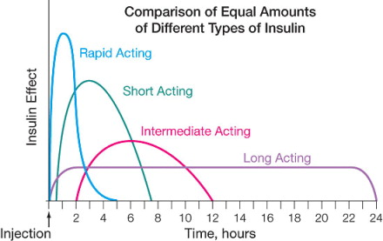
Action Profiles of Insulin Analogues
Image from:http://openi.nlm.nih.gov/detailedresult.php?img=2276216_1750-4732-2-4-3&req=4

Slide 15
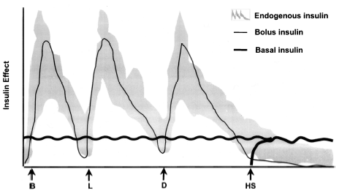
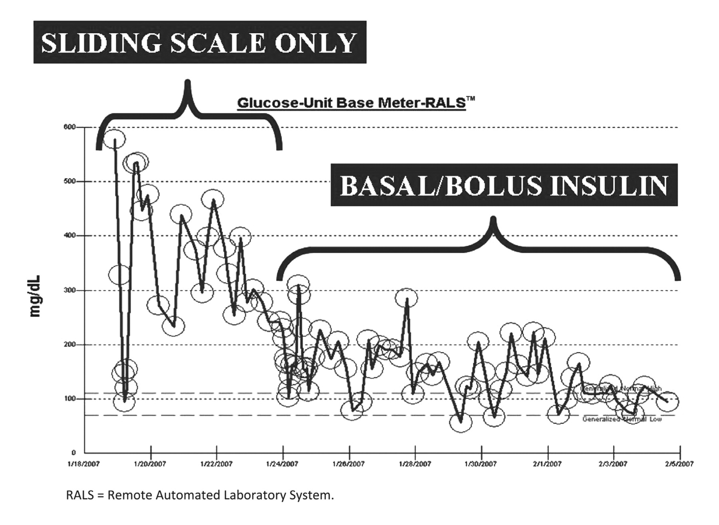
Basal-bolus insulin Therapy
Mimics physiological release of insulin
Images from:http://labmed.ascpjournals.org/content/42/7/427/F1.large.jpg;http://www.shuishi.org/what-is-the-basal-insulin-production-in-nondiabetics/
Schmeltz LR. Management of Inpatient Hyperglycemia.Lab Med 2011;42(7):427-434
Notes:
-Best way to approach to glycemic control is to use mix of long and short acting insulin analogue to mimic the physiological release of insulin
-Using only a short/rapid acting can not achieve this effect
-Basal insulin:50% of daily need
-Bolus: 10-20% of total daily need at each meal

Slide 16
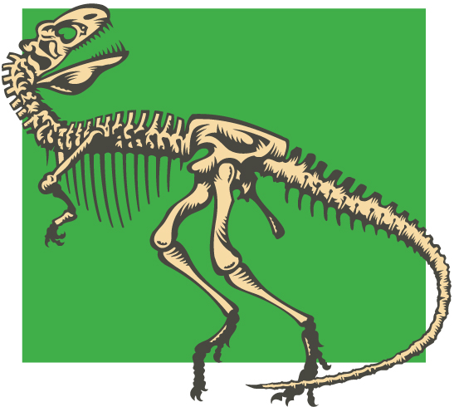

Barriers to Change
1) Tradition/Historical Practice
2) Fear of Hypoglycemia
Guillermo E, Umpierrez, Palacio A. Sliding scale insulin use: Myth or Insanity. The American Journal of Medicine.2007;120:563-567
Image from:http://animals.timduru.org/dirlist/dino/;http://blog.lawinfo.com/2012/11/09/weird-laws-true-or-false-edition-10/
Notes:
By using ISS, can hypoglycemic incidences be avoided or reduced?

Slide 17
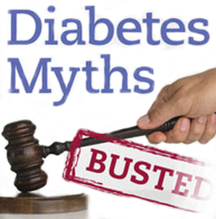
What Does Evidence Say About
ISS vs. BBI?
Umpierrez et al. Diabetes Care 2007: RABBIT 2 trial
Multicenter, randomized control trial
P | Inpatient with Type 2 Diabetes
I | Patients on insulin sliding scale only (ISS)
C | Patients on basal-bolus insulin regimen (BBI)
O | Higher % of patients in BBI arm achieved blood glucose target vs. patients in ISS arm 2) No increase in hypoglycemic events
Questions to consider….
1) Can this study be applied to patients with Type 1 Diabetes?
2) Can this study be applied to LTC residents?
We do the best with what we have!
Umpierrez GE, Smiley D, Zisman A. et al. Randomized study of basal-bolus insulin therapy in the inpatient management of patients with type 2 diabetes (RABBIT 2 trial). Diabetes Care 2007;30: 2181– 2186
Notes:
Lots of limitations:
Only type 2 diabetes
Open-label
Not double blinded

Slide 18
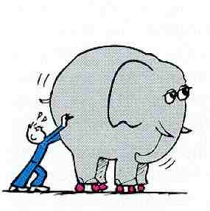
Barriers to Change cont….
3. Unaware of problems associated with ISS
4. Unwilling to make changes to therapies initiated by another physician
5. Lack of evidence
  Long-term care (LTC) setting
Roberts GW, Agullar-Loza N, Burt MG, et al. Basa-bolus versus sliding-scale insulin for inpatient glcaemic control: a clinical practice comparison
Notes:
-Unaware of problems associated with ISS
-Unwilling to make changes to therapies initiated by another physician

Slide 19

Insulin sliding scales IN LONG-TERM CARE

Slide 20
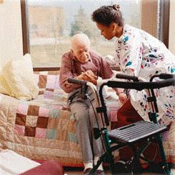
Why Is ISS an Issue in LTC?
1 out of 4 LTC resident in Ontario have diabetes¹
Study by Pandya et al. reported that ISS regimens
  a) were highly prevalent in LTC
  b) once initiated tended to persist²
Elderly are more vulnerable to the detrimental effects of poor glycemic control
1.Clement M, Leung F.Diabetes and the frail elderly in long term care.Can J Diabetes 2009.33(2):114-121
2.Pandya N, Thomptson S, Sambamoorhi U. The prevalence of persistence of sliding scale insulin use among newly admitted elderly nursing home residents with diabetes mellitus. JAMDA.2008; 9(9):663-669
Notes:
-the study indicated that once started, 83% would be left on ISS
-this is an big issue. This is also why I chose this topic
-We have already discussed that when used short term in hospitals they are ineffective method of glycemic control
-we have also discussed the fact that fluctuating BG levels could be an independent factor in causing poor outcomes/complications
-so can you imagine what it would mean for a elderly resident who would be on ISS chronically?
-elderly who have been discharged with ISS and admitted to LTC will likely be on ISS for months to years. Although no studies have looked into the long-term use of ISS, you could imagine what the patient goes through, having their blood glucose is constantly fluctuating.

Slide 21
Elderly & Hypoglycemia
Elderly are at high risk for hypoglycemia due to
  Loss of typical hypoglycemic responses
  Multiple chronic conditions and medication
Why the increase concern?
  ACUTE complication
  Cognitive and functional impairment
  Unrecognized
Complications
  Fall and fractures
  Seizures
  Hospitalization
  Death
Decreases Quality of Life (QOL)
Clement M, Leung F.Diabetes and the frail elderly in long term care.Can J Diabetes 2009.33(2):114-121
Notes:
-hypoglycemia=BS<4mmol/L
-elderly are at increased risk for complications especially hypoglycemia bc
1)They do not present with the typical symptoms of hypoglycemia that you would see in a younger patient. This is due to the fact that they have lower beta –adrenergic receptors in the body and will not present to adrenergic symptoms such as tremor and increase heart rate that we are familiarize as symptoms of hypoglycemia.
2) more medication and comorbidities=may effect absorption and breakdown of insulin medications such as
Why is this a problem
-hypoglycemia is an acute complications, meaning, when BS are low there are immediate consequences that occur and if not treated right away there are serious consequences including death
-problem is, treatment for hypoglycemia is often delay in LTC setting bc it was unrecognized and patients are not able to communicate the issue and get help
-hypoglycemia present as stroke, cardiac ischemia, and fall-all can lead to death
-symptoms differ (impaired conc., personality change) and unrecognized
-cognitive and functional impairments prevents elderly from self-treating and getting the necessary help that they need

Slide 22
How about Hyperglycemia?
Sustained elevation of blood glucose leads to progression of
  Microvascular complications
  Macrovascular complications
Controlling blood glucose levels (preventing hyperglycemia) slow the progression of these complications
What does it mean to an frail, elderly who
  Have decreased life expectancy (<5 years)?
  Established microvascular and macrovascular complications?
Parkin CG, Brooks N. Is postprandial glycose control important?Clinical diabetes 2002;20(2):71-76
Notes:
--sustained elevation of blood glucose=poor glycemic control (Hba1c is high)
-DCCT trial, the UKPDs trials that good glycemic control slowed the progression of these complications
-long term complications of damage to blood vessel
-macrovasular complications-cardiovascular complications
-microvascular complications-damage to the eyes, kidney, and nerves
--BS>14mmol/L
-remember to rap the benefits of good blood glucose control requires time (5-10 years). Time that most long-term residents don’t’ have
-if complications have already been established how much benefit is the resident going to have. Remember, these complications cannot be reversed, the progression can be delayed
-How much benefit do you think resident will have from tight glycemic control

Slide 23
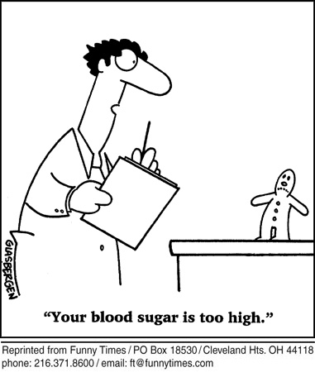
Hyperglycemia Still Important!
Acute/Sub-acute complications associated with sustained hyperglycemia:
  UTIs
  Infections
  Skin ulcers
  Impairs cognitive function
  Weight loss
  Prevent wound healing
  Polyuria/Nocturia
  Dehydration
  Falls (Indirect)
⬇ QOL
Clement M, Leung F. Diabetes and the frail elderly in long term care.Can J Diabetes 2009.33(2):114-121
Notes:
Once again, the symptoms of hyperglycemia can often go un-noticed until too late
on bunch of meds such as corticosteroids, NSAIDs that exacerbate hyperglycemia

Slide 24
Glycemic Control in Elderly
Glycemic Targets for the elderly
 | Hemoglobin A1C (%) | Fasting blood glucose or pre-prandial glucose (mmol/L) | 2-h post-prandial glucose (mmol/L)
Healthy elderly | <7 | 4-7 | 5-10
Frail elderly | <8 | <10 | <14
VADT, ADVANCE, ACCORD studies demonstrated that tight glycemic control increased the risk of hypoglycemia
Regier L, Bareham J, Jensen B. RxFiles Q&A: glycemic targets in the frail elderly. Saskatoon, SK: RxFiles; 2011
Notes:
-CDA does not define specific goals and targets for elderly in LTC bc lack of research in LTC with tight control
--VADT, ADVANCE, ACORD studies demonstrated that tight glycemic control (HbA1C <7%) increased the risk of hypoglycemia
-As discussed earlier, most LTC residents will not benefit from glycemic control, but if you are going to set a target you may consider the following
-not all elderly are the same
-if they are healthy and you think they will live long enough to benefit of glycemic control than you may consider tight glycemic control.
-most likely than not, however patient will be frail and will be vulnerable to poor outcomes such as hypoglycemia. For these patients consider less stringent targets (hba1c =8%) bc risks outweighs benefit as seen by VADT,ADVANCE, ACCORD studies

Slide 25
Managing Diabetes in LTC: TIPS
Diabetes care must be individualized, flexible, and consider quality of life
Individualize glycemic targets based on:
    Life expectancy
    Functionality
Address hypoglycemia first then hyperglycemia
Change insulin therapy based on blood glucose pattern
  Do not change based on single BG reading
  Adjust one insulin at a time
Treat the patient not the number
Clement M, Leung F. Diabetes and the frail elderly in long term care.Can J Diabetes 2009.33(2):114-121
Notes:
Due to lack of studies evaluating diabetes control and treatment in LTC, there are limited information and guidelines out there for physicians to look at and follow. Most guidelines would go along the line: Use clinical judgement and which is why practice widely varies
-hypoglycemia will kill you fast, hyperglycemia will kill you more slowly
-Individualize glycemic targets and goals of therapy based on: CONSIDER LESS STRINGENT A1C TARGET!
-life expectancy
-functionality
The focus of this presentation is on pharmacological approach but don’t forget to consider dietary (medical nutrition therapy) and physical activity modification (improve insulin sensitivity)-light moderate exericse

Slide 26
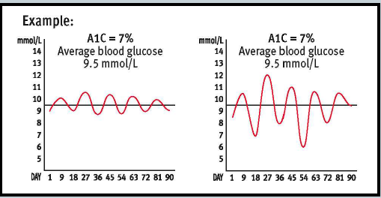
Limitations of A1C
Treat the PATIENT and not the NUMBERS
Image from:http://healthesolutions.com/why-equal-a1c-results-can-be-very-different/

Slide 27
General Goals of Therapy for LTC Residents
Prevent onset of acute complications
  Prevent hypoglycemia
  Avoid symptoms of hyperglycemia
  Limit acute side-effects of insulin
    (i.e. weight gain)
Maintain Quality of Life and maximize daily functions
D/C ISS
Johnson EL, Brossuau JD, Soule M.Treatment of Diabetes in long-term facilities: a primary care approach. Clin Diabetes 2008; 26(4):152-156
Notes:
Emphasis should be on preventing complications of hypoglycemia and hyperglycemia (i.e cognitive deline, nocturia, and falls)
Quality of life:
Maximize daily function
Reducing pain, infections, and nocturia
Improving incontnuece
Preveting falls and limting cogntive imparment
Consider how it may effect their quality of life

Slide 28
Case 1: Mr. DB
Frail, 82 year old male with T2D for the last 50 years
Most recent A1C=8%
On insulin sliding scale QID (started 3 months ago)
4 episodes of hypoglycemia in the last month (in the middle of night)
1 fall in the last month
Recently appears to have difficulty focusing
BS readings are all over the map with no consistent pattern
Physician decides not to make any changes to patient’s insulin therapy. Would you agree with the physician’s decision?
Yes, since patient has reached target A1C (for frail elderly)
No, D.B needs to switch to another sliding scale considering BS readings are all over the map
No, Need to discontinue ISS and start basal insulin. Follow-up in 2 weeks to observe BS patterns and start bolus insulin.

Slide 29
Case 1: Mr. DB
Frail, 82 year old male with T2D for the last 50 years
Most recent A1C=8%
On insulin sliding scale QID (started 3 months ago)
4 episodes of hypoglycemia in the last month (in the middle of night)
1 fall in the last month
Recently appears to have difficulty focusing
BS readings are all over the map with no consistent pattern
Physician decides not to make any changes to patient’s insulin therapy. Would you agree with the physician’s decision?
Yes, since patient has reached target A1C (for frail elderly)
No, D.B needs to switch to another sliding scale considering BS readings are all over the map
No, Need to discontinue ISS and start basal insulin. Follow-up in 2 weeks to observe BS patterns and start bolus insulin.
Notes:
As discussed earlier the presentation, basal-bolus insulin regimen is preferred over insulin sliding scale. Why was that again? That will be answered in my next question.

Slide 30
Case 1 cont.….
When making your recommendation to the physician, what information might you want to include?
Basal-bolus is a proactive approach to management, preventing hyperglycemia without increasing the risk of hypoglycemia
The use of insulin sliding scale is not evidence-based practice
Insulin sliding scale is most likely the medication causing the patient to fall and affecting patient’s ability to focus
All of the above

Slide 31
Case 1 cont.….
When making your recommendation to the physician, what information might you want to include?
Basal-bolus is a proactive approach to management, preventing hyperglycemia without increasing the risk of hypoglycemia
The use of insulin sliding scale is not evidence-based practice
Insulin sliding scale is most likely the medication causing the patient to fall and affecting patient’s ability to focus
All of the above

Slide 32
Case 2: Again Mr. DB
The physician decides to take up your advice
Patient is now on basal insulin (Lantus 10units at night) BUT is also on supplemental insulin sliding scale TID before meals
What recommendation would you make as a pharmacist?
No recommendation, D.B’s current insulin therapy is perfect
Supplemental sliding scale may be used temporarily as a dose finding strategy to determine appropriate bolus doses. Recommend to re-evaluate and consider adjusting insulin therapy in 2 week
Supplemental sliding scales are not acceptable, recommend to discontinue it immediately

Slide 33
Case 2: Again Mr. DB
The physician decides to take up your advice
Patient is now on basal insulin (Lantus 10units at night) BUT is also on supplemental insulin sliding scale TID before meals
What recommendation would you make as a pharmacist?
No recommendation, D.B’s current insulin therapy is perfect
Supplemental sliding scale may be used temporarily as a dose finding strategy to determine appropriate bolus doses. Recommend to re-evaluate and consider adjusting insulin therapy in 2 week
Supplemental sliding scales are not acceptable, recommend to discontinue it immediately

Slide 34
Role of the Pharmacist

Slide 35
Multidisciplinary Management Approach
Role of the pharmacist: Get everyone on board!
Physicians:
                Discontinuing ISS
                Initiating patient-specific basal-bolus insulin therapy
Nurses/Patients & family members:
                Recognize signs and symptoms of hyper- and hypoglycemia
                Treat hypoglycemia and severe hyperglycemia
Nursing Home:
        Help develop and implement protocols to initiate basal-bolus insulin therapy
Recommend
Educate to
Notes:
DM is a complex disease requiring multidisciplinary management approach
Its wonderful that you know the information surrounding ISS, but change does not occur unless you have everyone on board
Avoid “insulin stacking”

Slide 36

Tips on persuading physicians to uptake your recommendation(s)
Don’t give up!
All about the “wording”
Provide evidence
Check patient’s history
Reinforce the idea that this is in the best interest of the patient
Mention specific guidelines to support your thought
Notes:
-Do your background check-does patient has history of falls, frequent UTIs
-wording: instead of: as I said before in my last 3 recommendations, please discontinue insulin sliding scale
Say: As previously mentioned, insulin sliding scales are inappropirate in LTC bc of x,y,z. Please consider discontinuing ISS (DON’T OFFEND THE PHYSICIAN-it is important to form a good relationship with the prescribers

Slide 37
What Do Guidelines Say?
CDA guideline:
  “For hospitalized patients with diabetes treated with insulin, a proactive approach…is preferred over the sliding scale”¹
  Does not discuss ISS use in LTC facilities
American Geriatric Society:
  Recently (2012) updated Beers list to include sliding scale
  “Avoid. Higher risk of hypoglycemia without improvement in hyperglycemia management regardless of care setting”²
1.Canadian Diabetes Association Clinical Practice Guidelines Expert Committee. Canadian Diabetes Association 2008 clinical practice guidelines for the prevention and management of diabetes in Canada. Can J Diabetes 2008;32(suppl 1):S1-S201.
2.American Geriatrics Society. Updated Beers MH. Explicit criteria for determining potentially inappropriate medication use by the elderly: an update. Arch Intern Med. 1997;157(14):1531–6

Slide 38
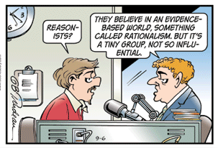



AGS Beers Criteria
List of inappropriate medications for the elderly
FREE Pocket pamphlet available on-line and on my website!
The miracles that the words “According to AGS Beers Criteria…” can produce…
From:http://www.mbalifecycle.com/blog/bid/37560/MBA-Market-Research-Empowering-Data-Driven-Decision-Making

Slide 39

Key Messages
STOP the use of insulin sliding scales
  Not evidence-based practice
Recommend basal-bolus insulin regimens
  “Proactive” approach
ISS in LTC is of particular concern
  Elderly are vulnerable to complications
Pharmacists play an important role
  Role of an educator

Slide 40

Questions?
Image from:http://alternateeconomy.wordpress.com/2012/05/16/when-i-question/

Slide 41
References
Jain VV, Taksande B. Sliding scale insulin therapy-evidence based rebuke.J MGIMS 2008.13(2) 29-31
Umpierrez GE, Palacio A, Smiley D. Sliding scale insulin use: myth or insanity? Am J Med 2007; 120: 563– 567
Nalysnyk L, Hernandez-Medina M, Krishnarajah G. Glycaemic variability and complications in patients with diabetes mellitus: evidence from a systematic review of the literature. Diabetes Obes Metab. 2010;12(4):288-298
Umpierrez GE, Smiley D, Zisman A. et al. Randomized study of basal-bolus insulin therapy in the inpatient management of patients with type 2 diabetes (RABBIT 2 trial). Diabetes Care 2007;30: 2181– 2186
Kitibachi AE, Nwenye E. Sliding-scale insulin: more evidence needed before final exit? Diabetes Care 2007;30:2409-2410
Roberts GW, Agullar-Loza N, Burt MG, et al. Basa-bolus versus sliding-scale insulin for inpatient glcaemic control: a clinical practice comparison
Clement M, Leung F.Diabetes and the frail elderly in long term care.Can J Diabetes 2009.33(2):114-121
Pandya N, Thomptson S, Sambamoorhi U. The prevalence of persistence of sliding scale insulin use among newly admitted elderly nursing home residents with diabetes mellitus. JAMDA.2008; 9(9):663-669
Regier L, Bareham J, Jensen B. RxFiles Q&A: glycemic targets in the frail elderly. Saskatoon, SK: RxFiles; 2011
Johnson EL, Brossuau JD, Soule M.Treatment of Diabetes in long-term facilities: a primary care approach. Clin Diabetes 2008; 26(4):152-156
.Canadian Diabetes Association Clinical Practice Guidelines Expert Committee. Canadian Diabetes Association 2008 clinical practice guidelines for the prevention and management of diabetes in Canada. Can J Diabetes 2008;32(suppl 1):S1-S201.
American Geriatrics Society. Updated Beers MH. Explicit criteria for determining potentially inappropriate medication use by the elderly: an update. Arch Intern Med. 1997;157(14):1531–6
Browning LA, Dumo P. Sliding-scale inulin: An antiquated approach to glycemic control in hospitalized patients. Am J Health-Syst Pharm. 2004; 61:1611-4.
Parkin CG, Brooks N. Is postprandial glycose control important?Clinical diabetes 2002;20(2):71-76
Schmeltz LR. Management of Inpatient Hyperglycemia.Lab Med 2011;42(7):427-434

Slide 42
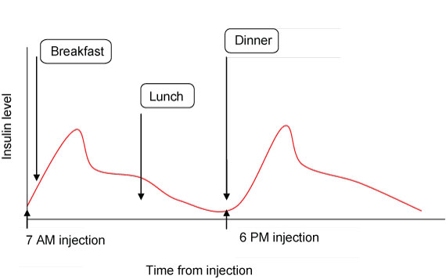
Basal-Bolus Insulin Regimen
(Twice-daily Split-mixed Regimens)
Schoeffler JM, Rice DAK, Gresham DG: 70/30 insulin algorithm versus sliding scale insulin. Ann Pharmacother 39:1606–1610, 2005
Twice daily Insulin aspart protamine/insulin aspart 70/30
-Alternative for elderly patient
-convenient
BID 70/30 insulin therapy was superior to ISS in glycemic control (small study-10 pt enrolled) in hospital
NPH
Does NOT Mimic physiological release of insulin
Notes:
Additionally, this study corroborates similar findings in a smaller prospective but nonrandomized study comparing insulin 70/30 (the ratio of 70% NPH to 30% regular insulin) with SSI, in which both groups received a comparable dose of insulin (13).

